Slide 1

R Markdown
Andrew Jones | Strategy Unit

Slide 2


Introduction to R and RStudio
Session 8: Intro to R Markdown

Slide 3
What is R Markdown?
R Markdown allows you to combine:
Code
Results
Prose
in a fully reproducible document.
Supports Word, PDF, Slide…. outputs

Slide 4
Why use R Markdown?
To communicate to decision makers.
To collaborate with other analysts.
To capture what you were thinking as well as what you did.

Slide 5
When use R Markdown?
as a rough guide:
When more code than text: R script
When more text than code: R Markdown

Slide 6
Overview
Metadata (heading)
Text
Code (R, SQL, Python …)

Slide 7
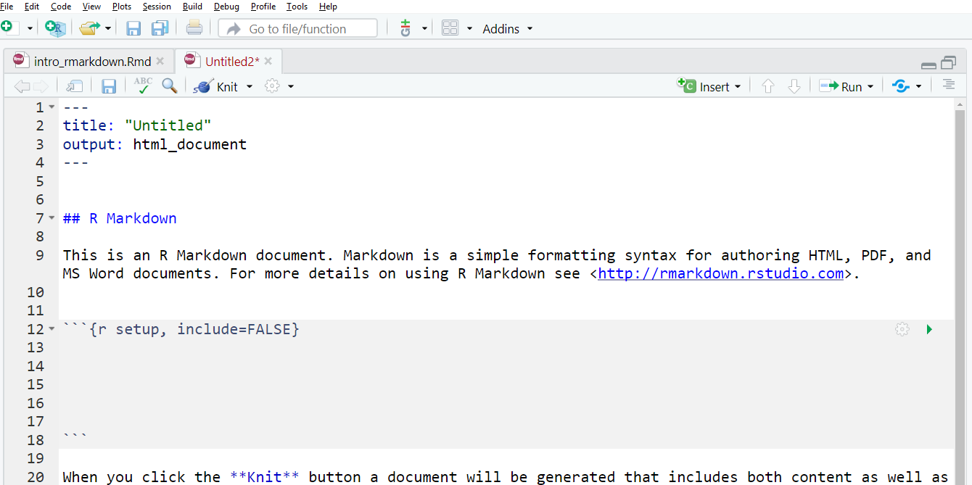
It looks like this:

Slide 8
It looks like this:
YAML
Text
Code inside these “chunks”

Slide 9
YAML
Controls document settings
Not important for now.
Title author date

Slide 10
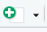
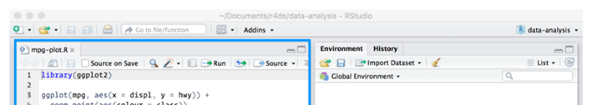
You can start a new R Markdown document (or R Notebook) by clicking
But…

Slide 11
Please open the tutorial:
intro_rmarkdown.rmd

Slide 12

More in:
https://r4ds.had.co.nz/

Slide 13
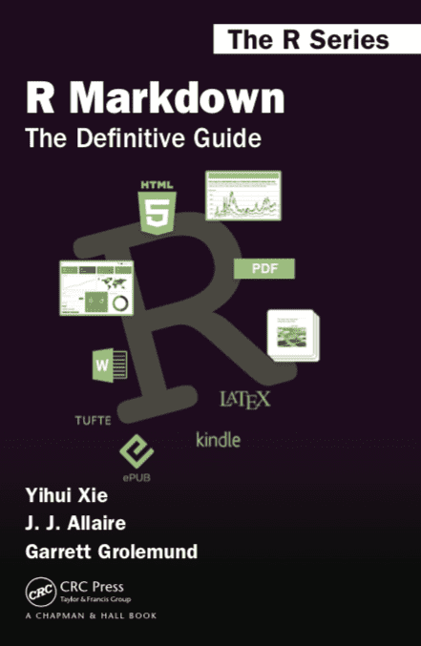
Much more at:
https://bookdown.org/yihui/rmarkdown/

Slide 14
This material was created for the NHS-R community by:
Andrew Jones @The Strategy Unit
The work is licenced under:
Creative Commons
Attribution-ShareAlike 4.0
International
To view a copy of this license, visit
https://creativecommons.org/licenses/by-sa/4.0/

Slide 15
End

